Slide 1
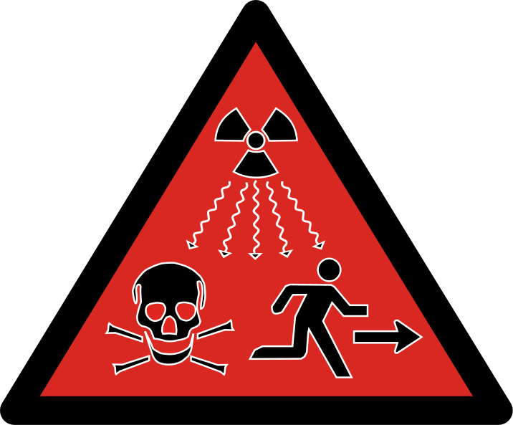
Radiation
IN ORDER TO UNDERSTAND RADIATION PHYSICS, ATOMIC MODEL HAS TO BE KNOWN WELL

Slide 2
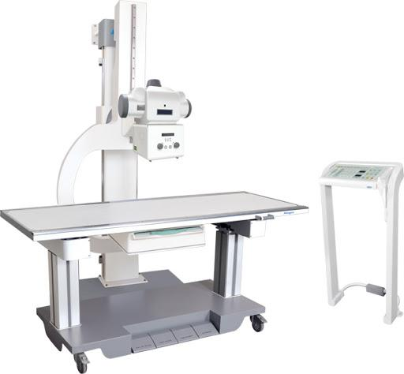
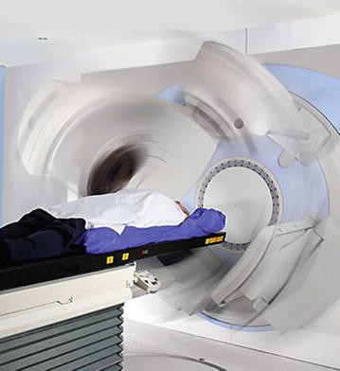
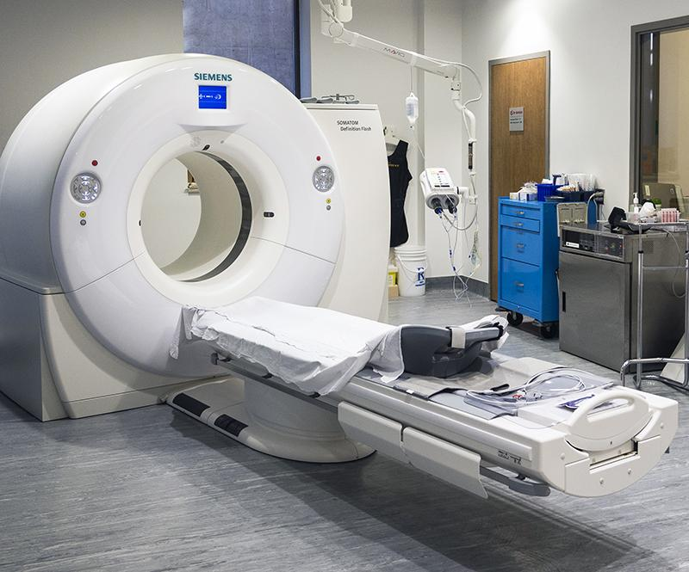

Motivation Radiation is used in our daily life, especially in medical imaging. X-ray Imaging, Computed Tomograpy, Radiotherapy ,Fluoroscopy , SPECT, PET .....

Slide 3
Learning Objectives
Radiation
Elektromagnetic Spectrum
Differences between ionizing and non-ionizing radiation
Differences between radioactivity and radiation

Slide 4
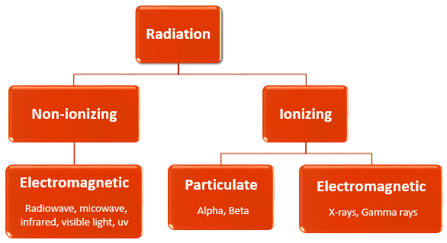

Radiation
Radiation is the release of energy in electromagnetic waves or particles
This energy can be low level or high level
Low-level energy is like microwave and radiowave
High-level energy is like X-rays or gamma rays

Slide 5
Radiation
Radiation fall into two main categories.
ionizing and non-ionizing, depending on its energy and ability to penetrate matter.
Ionizing radiation has enough energy to remove bound electrons, cousing atoms to become ionized
Electron removal from an atom is called ionization.
.
Non-ionizing radiation doesn’t have enough energy to removed bound electrons.

Slide 6
Radiation
Particulate radiation consists of particles that have mass and energy.
Electromagnetic radiation, consists of photons that have energy, but no mass or charge.
A photon is sometimes described as a “packet of light”.

Slide 7
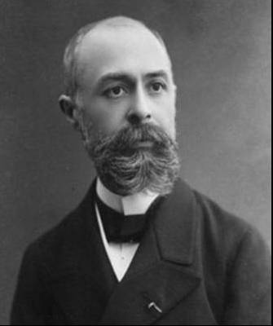
Radioactivity
was discovered by Becquerel in 1896
is the property of some unstable atoms (radionuclides) to emit nuclear radiation spontaneously
Nuclear decay = radioactivity
Unstable atoms = radionuclides
Radioactive decay three main types of radiation are emitted
Alpha
beta
gamma
Antoine Henri Becquerel
Notes:
How long has it been?
Henri discovered radioactivity back in 1896!
That means that we’ve been studying radiation and its effects on humans for more than 100 years!

Slide 8
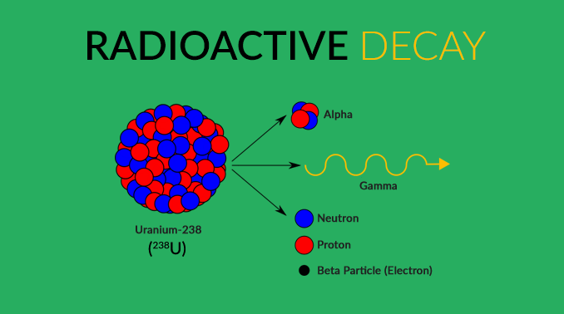
What is the difference between radioactivity and radiation?
Radiation is the energy or particles that are released during radioactive decay.
Radioactive materials are materials that emit radiation.

Slide 9
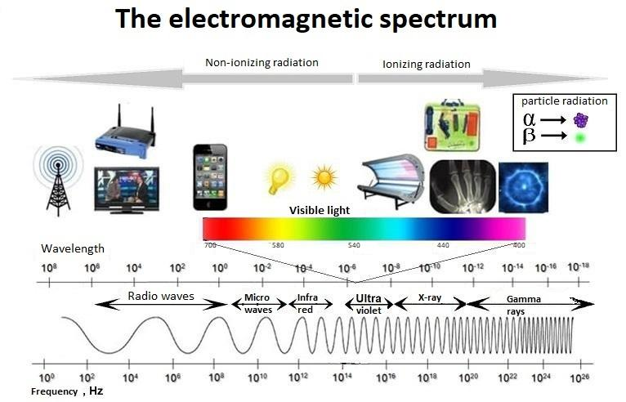
Here we are concerned with only ionizing radiation

Slide 10
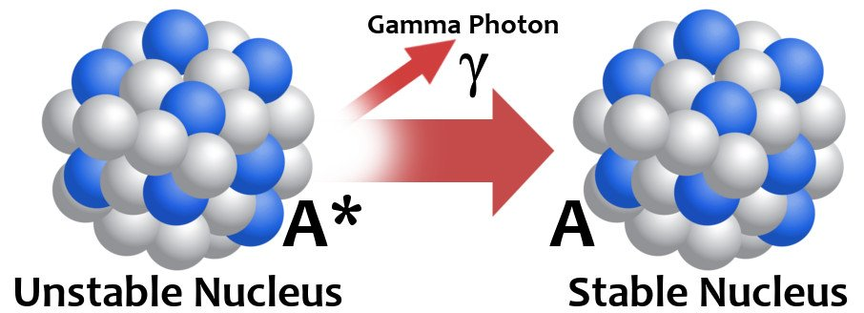
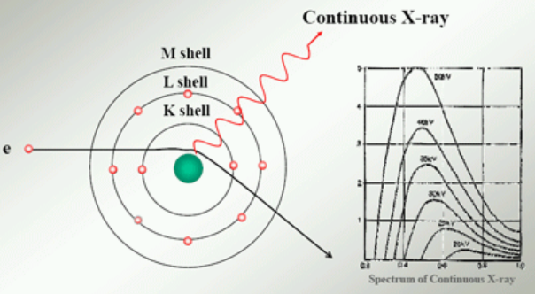
Ionizing Electromagnetic Radiation (What is the difference between gamma rays and X-rays?)
There are two types of electromagnetic waves that can ionize atoms: X-rays, gamma-rays
The key difference between gamma rays and X-rays is how they are produced.
Gamma radiation is produced in the nucleus,
X-rays are produced outside of the nucleus by electrons.
In addition, the energies of gamma-rays are generally higher than the energies of x-rays.

Slide 11
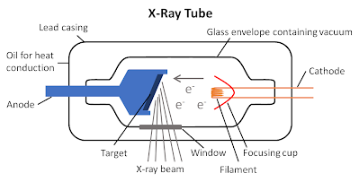
X-Ray (1895 by Wilhelm Conrad Rontgen)
X-ray is electromagnetic radiation.
It can be generated artificially
Today, x rays are mostly produced inside the x-ray tube.
Electron is accelerated first
X-rays are produced when high-speed electrons are slowed down at the anode (positively charged electrode) of an X-ray tube.

Slide 12
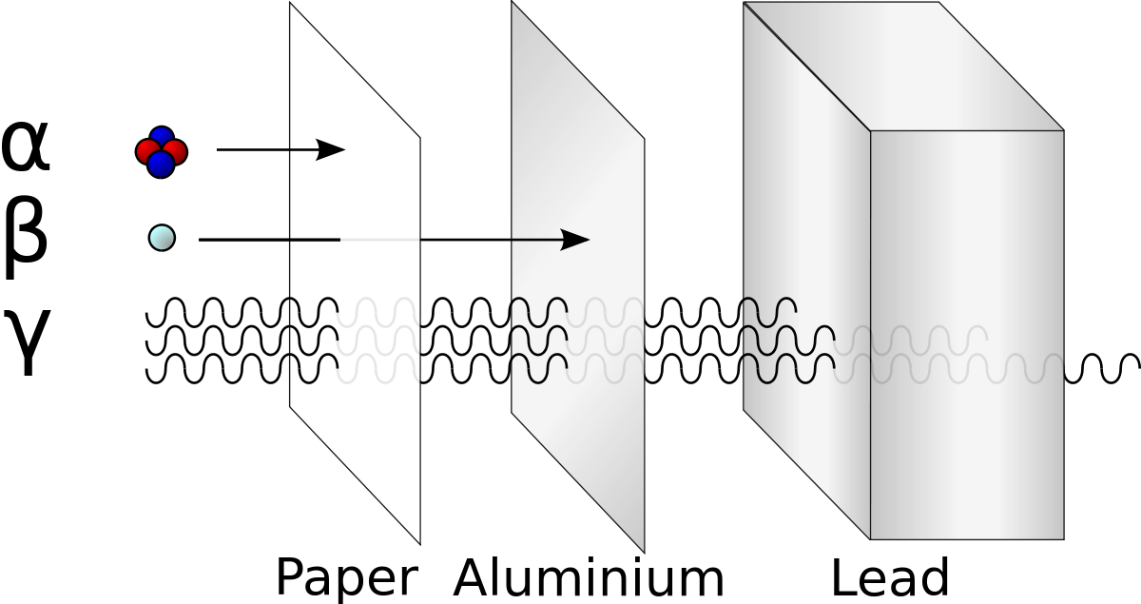
Gamma-Ray
is a packet of electromagnetic energy
is the most energetic photons in electromagnetic spectrum.
is emitted from the nucleus some unstable (radioactive) atoms.
penetrates matter very easily.
is harmful to living beings as it penetrates deeply into tissue.
Heavy materials such as lead and concrete are used as shielding.

Slide 13
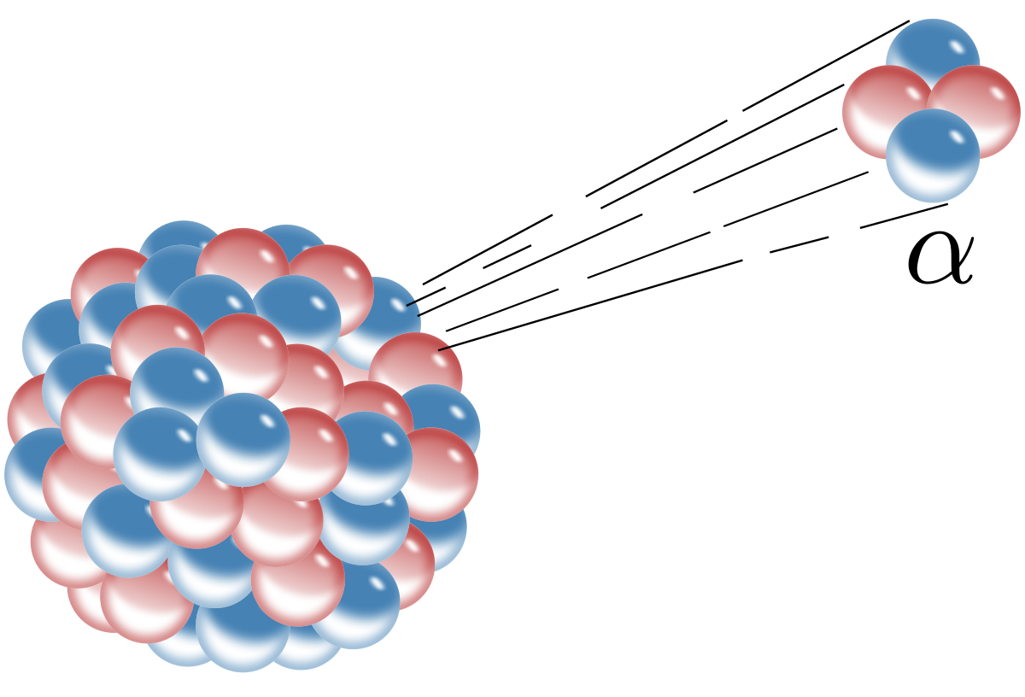
Alpha Radiation
is particle radiation consisting of two protons and two neutrons.
is emitted from the nucleus of some radionuclides during radioactive decay.
is absorbed very quickly by matter
have only a very short range
can be shielded by a sheet of paper.

Slide 14
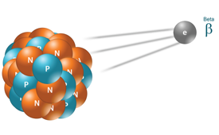
Beta Radiations (β)
are high energy, high speed electrons (β⁻) or positrons (β⁺)
are emited from the nucleus by some radionuclides during radioactive decay
can be shielded easily, for example, by an aluminium sheet a few millimetres thick.
has a lower biological effectiveness than alpha radiation.

